Slide 1

SKN Sinhgad Institute of Technology And Science Lonavala Department of Information Technology (A.Y.:- 2022-23)
Project Presentation
On
Leukemia Diagnosis Using Deep Learning
Roll No | Name
28 | Ujjwal Kunwar
15 | Manthan Gandalwad
16 | Akash Shinge
14 | Narsing Gurme
Under Guidance of
Prof. S.W. Puranik

Slide 2
Leukemia Diagnosis Using Deep Learning
Project Area : Deep Learning
Sponsorship : -
External Guide :

Slide 3
Outline
Module Description
Procedure
Data Flow Diagram
UML Diagram
Use case Diagram
Activity Diagram
Class Diagram
Sequence Diagram
Plan of the project- Gantt Chart
Applications
Conclusion (s)
References
Introduction
Leukemia Cell Images
Motivation
Aim & Objectives
Problem Statement
Probable Solution
Literature Survey
Preferred Technology
System Requirement
Project Analysis and Design
CNN Architecture
Systems Architecture

Slide 4
Introduction
Leukemia is an aggressive disease related to the white blood cells (WBC), it affects the bone marrow and blood of the human body.
This disease can lead to destroying the immune system of the human body.
There are two main types of leukemia acute and chronic leukemia, which is depending on how fast it progresses.
In acute leukemia, infected WBC do not perform or act like the normal WBC; while it can act as normal WBC in chronic leukemia. Therefore, chronic leukemia can be severe since it cannot be differentiated from normal WBC.
Moreover, there are two subtypes of each leukemia types depending on the size and the shape of the WBC: Lymphoid and myeloid.
Identifying the existence of leukemia as well as their specific types is important for hematologists to avoid medical risks and specify the right therapy. Thus, using intelligent ways for diagnosis will facilitate and speed up the discovery of leukemia subtypes using the blood cells images (i.e., blood smears).
In this study, we propose a new approach for leukemia diagnosis from microscopic blood images identifying the four subtypes of leukemia (i.e., ALL, AML, CLL, and CML) by using CNN architecture of deep learning.

Slide 5
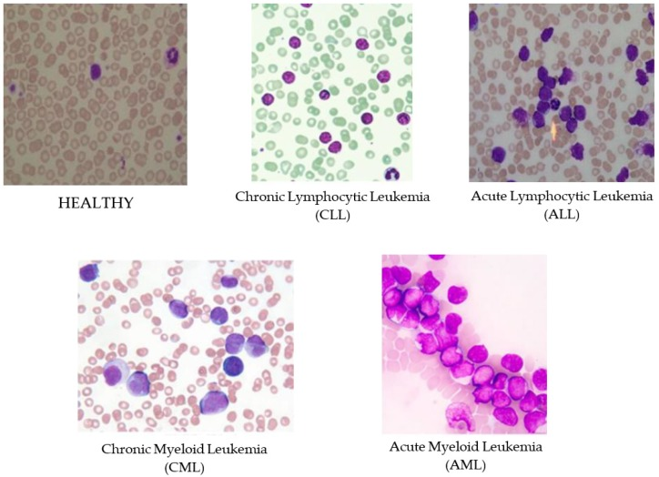
Leukemia Cell Images

Slide 6
Motivation
Motivated by the capabilities of deep learning(machine learning (ML)) in disease diagnosis, the present systematic review is conducted to review the studies aiming to discover and classify leukemia by using Deep Learning.

Slide 7
Aim and Objective(s)
The purpose of our project is to develop a system that can automatically detect cancer from the blood cell images.
This system uses a convolution network that inputs a blood cell images and outputs whether the cell is infected with cancer or not.
The appearance of cancer in blood cell images is often vague, can overlap with other diagnoses, and can mimic many other benign abnormalities.
These discrepancies cause considerable variability among medical personnel in the diagnosis of cancer.
Automated detection of cancer from blood cell images at the level of expert medical personnel would not only have tremendous benefit in clinical settings, it would also be invaluable in delivery of health care to populations with inadequate access to diagnostic imaging specialists.

Slide 8
Problem Statement
To design a detection and diagnosis of Leukemia disease from MRI is crucial to decrease the rate of casualties.
Leukemia disease is difficult to cure, because the Leukemia disease has a very complex structure and the tissues are interconnected with each other in a complicated manner.
Despite many existing approaches, robust and efficient segmentation of Leukaemia disease is still an important and challenging task.
Leukaemia disease segmentation and classification is a challenging task, because Leukemia disease vary in shape, appearance and location.
It is hard to fully segment and classify Leukaemia disease from mono-modality scans, because of its complicated structure.
So we overcome that problem to classify the Leukemia disease.

Slide 9
Probable Solution
The detection of leukemia is still done manually using different machines
Here in this review we propose a system to detect leukemia using deep learning.
First an image of the cell will be provided to the system. Then the system will map this image with the existing images in the database. If the image is containing any symptoms of the leukemia then it will predict with an enhanced accuracy.
The highest accuracy which have been achieved up to now is 88 percent .By doing this project we aim to achieve up to 93 percent of accuracy.
By implementing this system the traditional manual systems can be replaced and the accuracy and efficiency can be improved

Slide 10
Literature Survey
Sr. No | Paper Name | Author | Description
1. | Identification Of Leukemia Diseases Based On Microscopic Human Blood Cells Using Image Processing | R. Sigit, M. M. Bachtiar and M. I. Fikri | This paper is a combination of two previous studies which will identify two types of leukemia using a method that has been used to identify one type of leukemia with an accuracy rate of 88%
2. | Automatic detection of acute myeloid leukemia from microscopic blood smear image | P. Kumar and S. M. Udwadia | The paper proposes a technique that automatically detects and segments the nucleus from white blood cells (WBCs) in the microscopic blood smear images. Segmentation and clustering is done using a K-Means algorithm, while classification is done using Support Vector Machine (SVM) with feature reduction.

Slide 11
Literature Survey
Sr. No | Paper Name | Author | Description
3. | Diagnosis of Leukemia and its types Using Digital Image Processing Techniques | T. Dharani and S. Hariprasath | The affected cells can be detected from the healthy cells. Further, the subtypes can also be diagnosed based on the type of cell affected. The detected cells can be classified by Support Vector Machine (SVM). The classification can also done by ANN, fuzzy in order to increase the accuracy and efficiency in the result.

Slide 12
Preferred Technology
Python –
Python is an interpreted, object-oriented, high-level programming language. Its high-level built in data structures, combined with dynamic typing and dynamic binding, make it very attractive for Rapid Application Development, as well as for use as a scripting language.
Python's simple, easy to learn syntax emphasizes readability and therefore reduces the cost of program maintenance.
Python supports modules and packages, which encourages program modularity and code reuse.
The edit-test-debug cycle is incredibly fast. Debugging Python programs is easy: a bug or bad input will never cause a segmentation fault. Instead, when the interpreter discovers an error, it raises an exception.
Python is very helpful for Machine Learning and Deep Learning.

Slide 13
System Requirement
HARDWARE RESOURCES REQUIRED:
RAM : 8 GB
Speed : 2.4 GHz
Hard Disk : 500 GB
SOFTWARE RESOURCES REQUIRED:
Operating system : 64 bit Windows 10.
Coding Language : Python

Slide 14
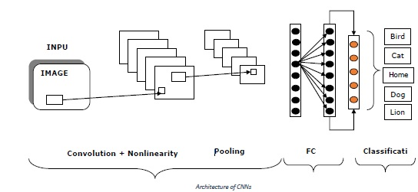
System Architecture

Slide 15
Procedure:
Step1: Provide MRI Image.
Step 2: verify the information into database.
Step 3: we propose Leukemia disease segmentation and classification method for multi-modality magnetic resonance image scans.
Step 4: The data from multi-modal brain tumor segmentation challenge are utilized which are co-registered and skull stripped, and the histogram matching is performed with a reference volume of high contrast.
Step 5: We are detecting Leukemia by using preprocessing, segmentation, feature extraction, optimization and lastly classification after that preprocessed images use to classify the tissue.
Step 6: As per comparison show Result.
Output: Getting images detect the Leukemia and show the result.

Slide 16
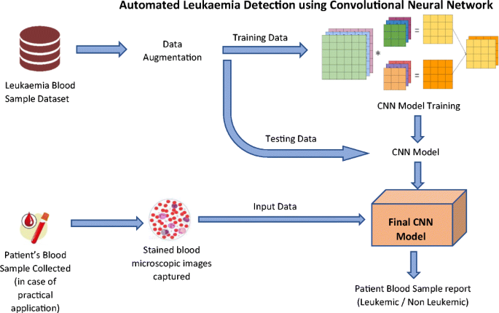
Procedure

Slide 17

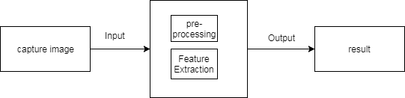
UML Diagrams: Data Flow Diagram:
a. DFD 0
DFD 1
b. DFD 1

Slide 18
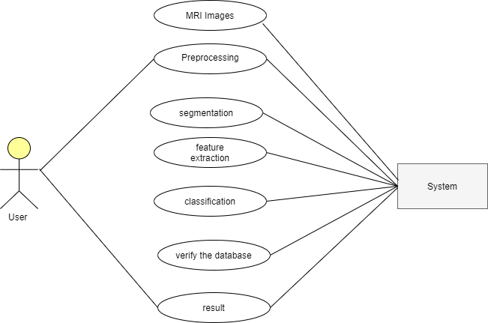
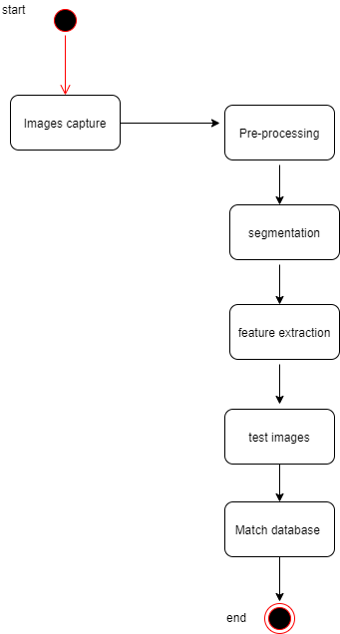
UML Diagrams:
Use Case Diagram
Activity Diagram

Slide 19
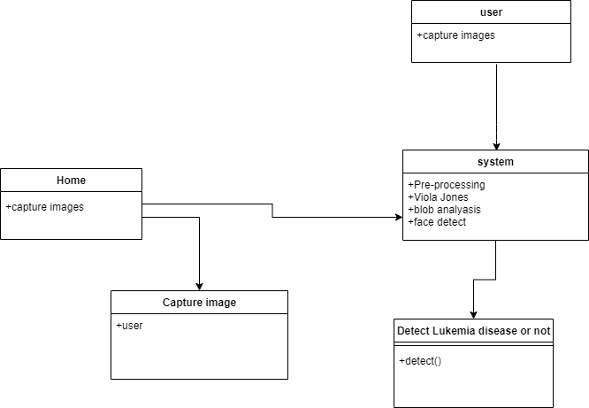
Class Diagram

Slide 20
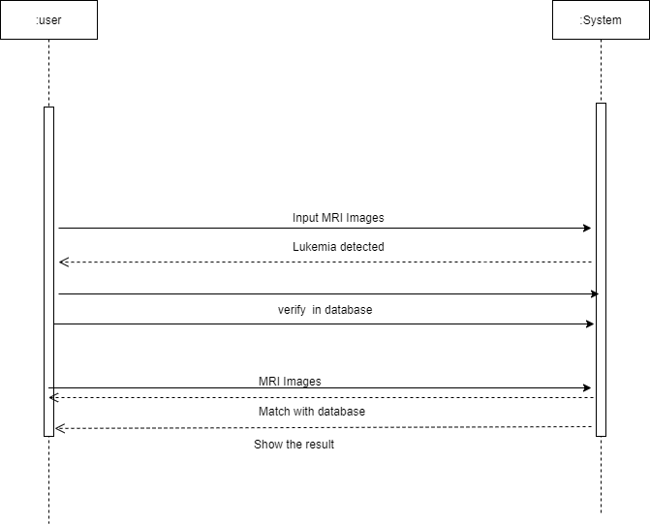
Sequence Diagram:

Slide 21
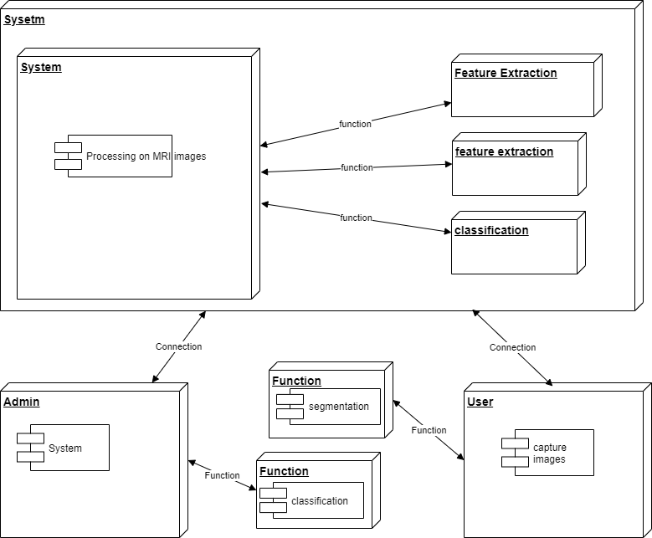
Deployment Diagram:

Slide 22
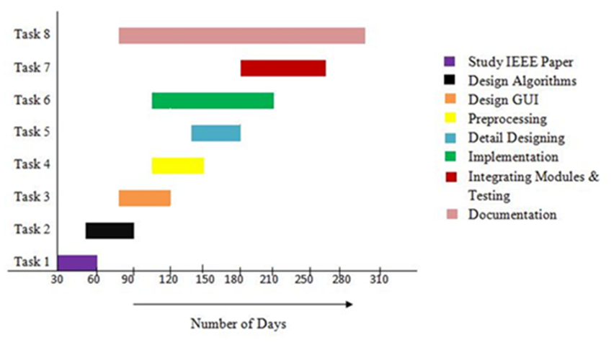
Project Timeline Chart:

Slide 23
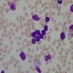
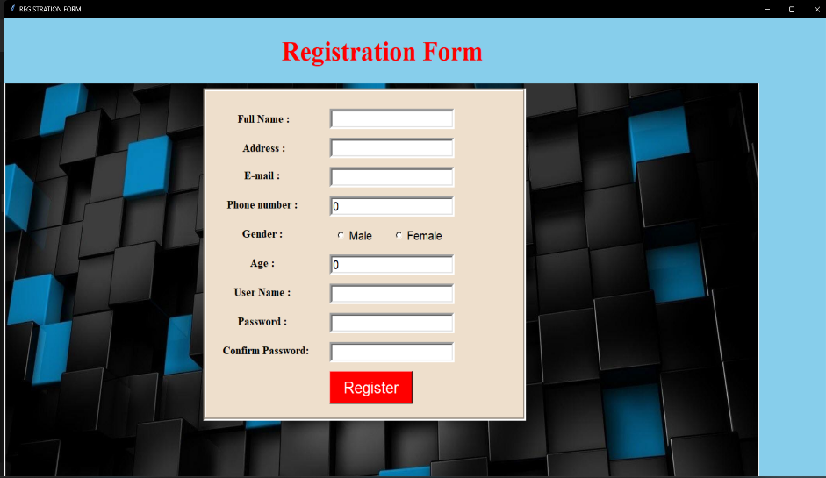
Experimental Results
1) Cell Image
2) Registration

Slide 24
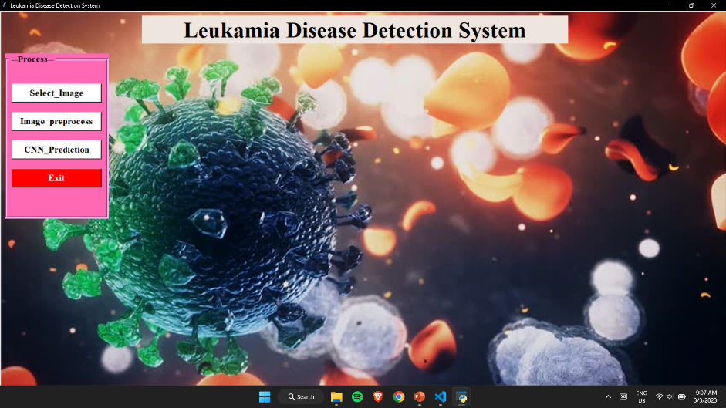
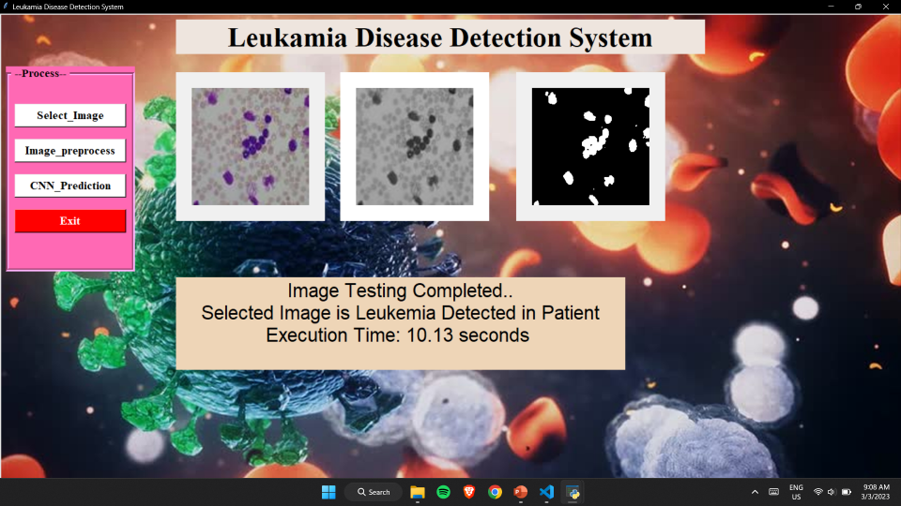
3) GUI
4) Leukemia Prediction

Slide 25
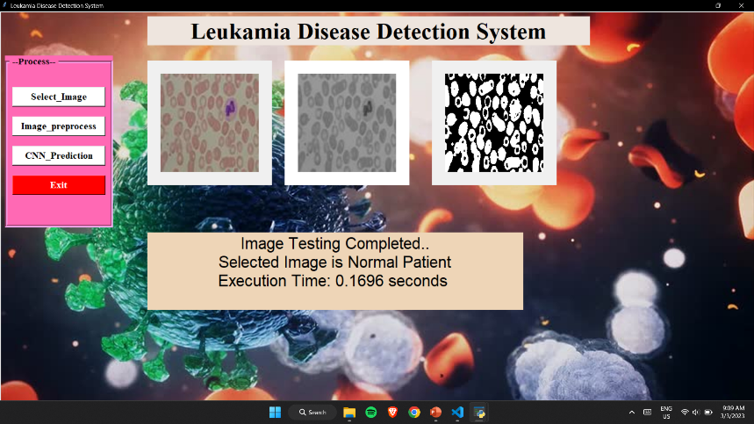
7. Leukemia Prediction

Slide 26
Advantages:
Required less time
Increase Efficiency
improve the accuracy.

Slide 27
Future Scope:
In future we plan to expand our experiments by using a hybrid deep learning approach using convolutional neural network accompanied by recurrent neural networks to enhance the performance. Furthermore, we plan to enlarge our dataset by adding new samples as well as using new data augmentation techniques.

Slide 28
Applications (if Applicable)
Our application can be used in hospitals.

Slide 29
Conclusion
This project presented an algorithm to hierarchically classify the leukemia disease Intensity, intensity difference, neighborhood information and wavelet features are extracted and utilized on multi-modality MRI scans with various classifiers. By use of wavelet-based texture features with CNN classifier we plan to increase the classification accuracy as evident by quantitative results of our proposed method which will be comparable or higher than the state of the art.

Slide 30
References
[1] R. Sigit, M. M. Bachtiar and M. I. Fikri, "Identification Of Leukemia Diseases Based On Microscopic Human Blood Cells Using Image Processing," 2018 International Conference on Applied Engineering (ICAE), 2018, pp.15, doi: 10.1109/INCAE.2018.8579387.
[2] P. Kumar and S. M. Udwadia, "Automatic detection of acute myeloid leukemia from microscopic blood smear image," 2017 International Conference on Advances in Computing, Communications and Informatics (ICACCI), 2017, pp. 1803-1807, doi: 10.1109/ICACCI.2017.8126106.
[3] T. Dharani and S. Hariprasath, "Diagnosis of Leukemia and its types Using Digital Image Processing Techniques," 2018 3rd International Conference on Communication and Electronics Systems (ICCES), 2018, pp. 275-279, doi: 10.1109/CESYS.2018.8724075.

Slide 31
Thank you

